Slide 1
CS 2200
Lab 3

Slide 2
Announcements
Homework 3 will be released today and is due Feb 7th @ 6:15 PM
Project 1 has been released and is due Feb 9th @ 11:59 PM

Slide 3

Today’s Topic:
Datapath, Microcontroller, & Interrupts

Slide 4
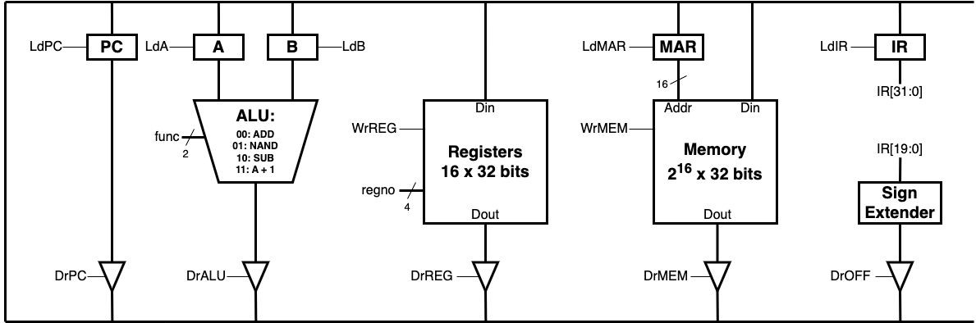
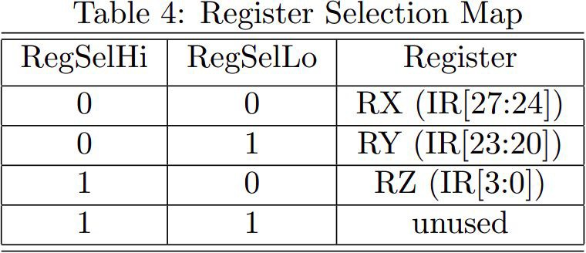
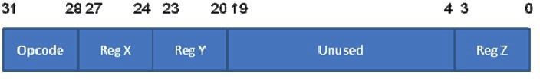
Exercise: Implement NAND on LC-2200 datapath
How many cycles and what control signals are required to implement NAND on the LC-2200 datapath? Spend 5 minutes tracing each cycle.
Anatomy of an R-type instruction.

Slide 5
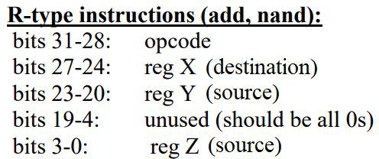
Implementing NAND
Store register Y in A
Store register Z in B
NAND A and B and store in register X

Slide 6
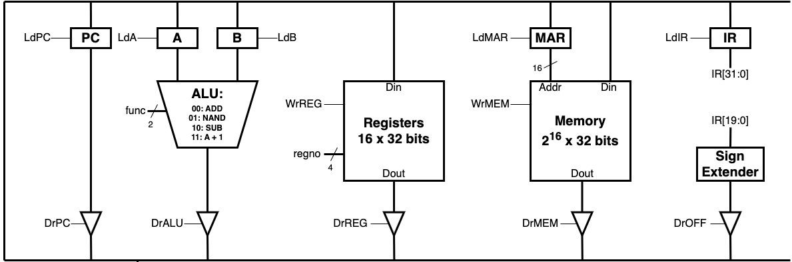
NAND Cycle 1: Ry → A
What signals need to be asserted?

Slide 7
NAND Cycle 1: Ry → A
DrReg, LdA, RegSel = 01

Slide 8
NAND Cycle 2: Rz → B
What signals need to be asserted?

Slide 9
NAND Cycle 2: Rz → B
DrReg, LdB, RegSel = 10

Slide 10
NAND Cycle 3: ALUOut → Rx
What signals need to be asserted?

Slide 11
NAND Cycle 3: ALUOut → Rx
DrALU, WrREG, func = 01, RegSel=00

Slide 12
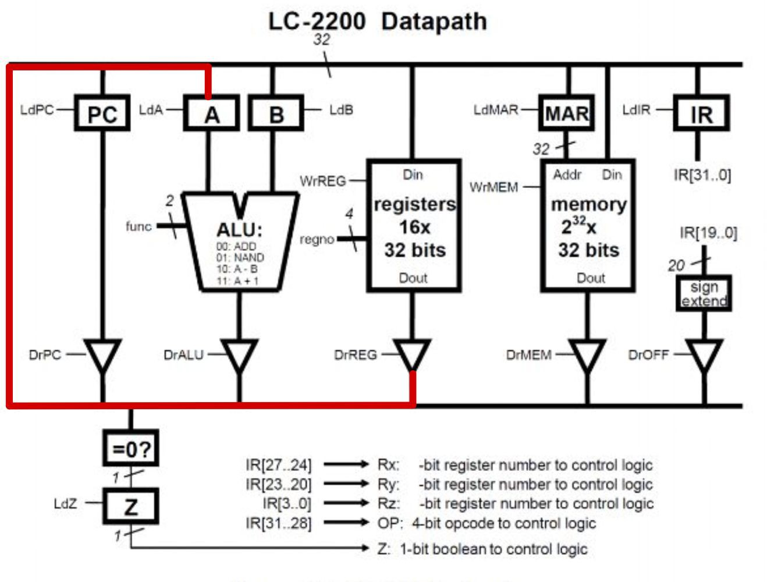
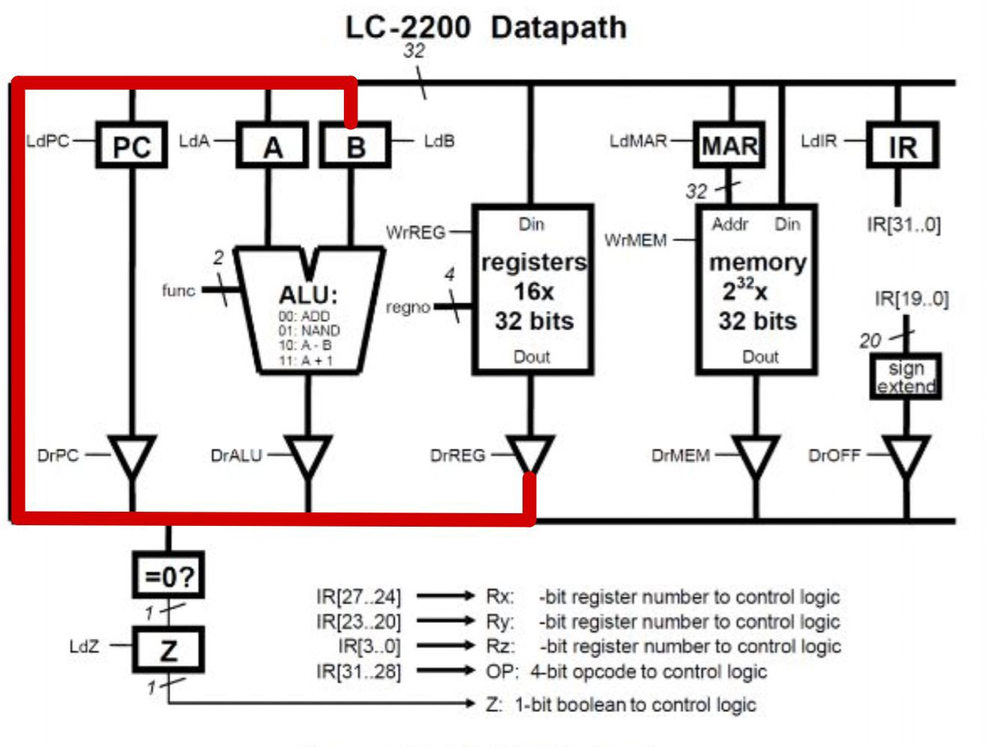
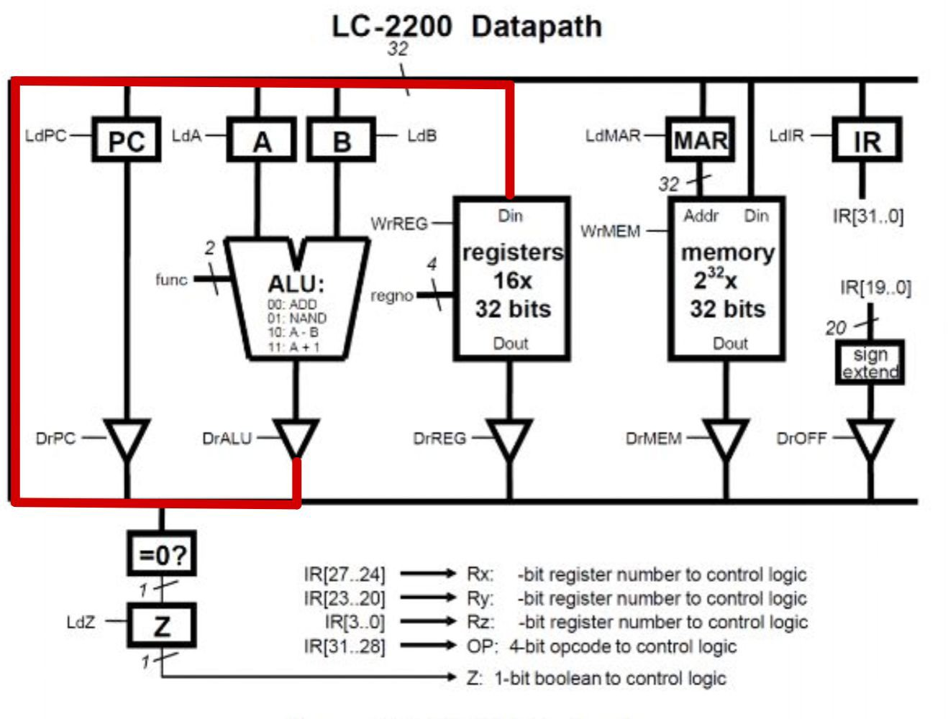
Implementing NAND
Cycle 1: DrReg, LdA, RegSel = 01
Cycle 2: DrReg, LdB, RegSel = 10
Cycle 3: DrALU, WrReg, func = 01, RegSel=00

Slide 13
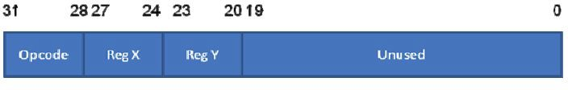
Exercise: Implement JALR on LC-2200 datapath
How many cycles and what control signals are required to implement JALR on the LC-2200 datapath? Spend 5 minutes tracing each cycle.
Anatomy of a J-type instruction.

Slide 14
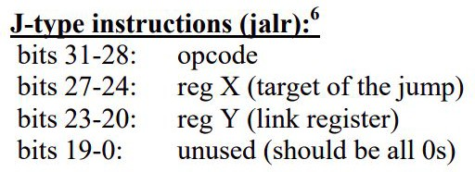
Implementing JALR
Store PC + 1 in Ry
Branch to the address in Rx

Slide 15
JALR Cycle 1: PC → Ry
What signals need to be asserted?

Slide 16
JALR Cycle 1: PC → Ry
DrPC, WrREG, RegSel = 01

Slide 17
JALR Cycle 2: Rx → PC
What signals need to be asserted?

Slide 18
JALR Cycle 2: Rx → PC
DrREG, LdPC, regSel = 00

Slide 19
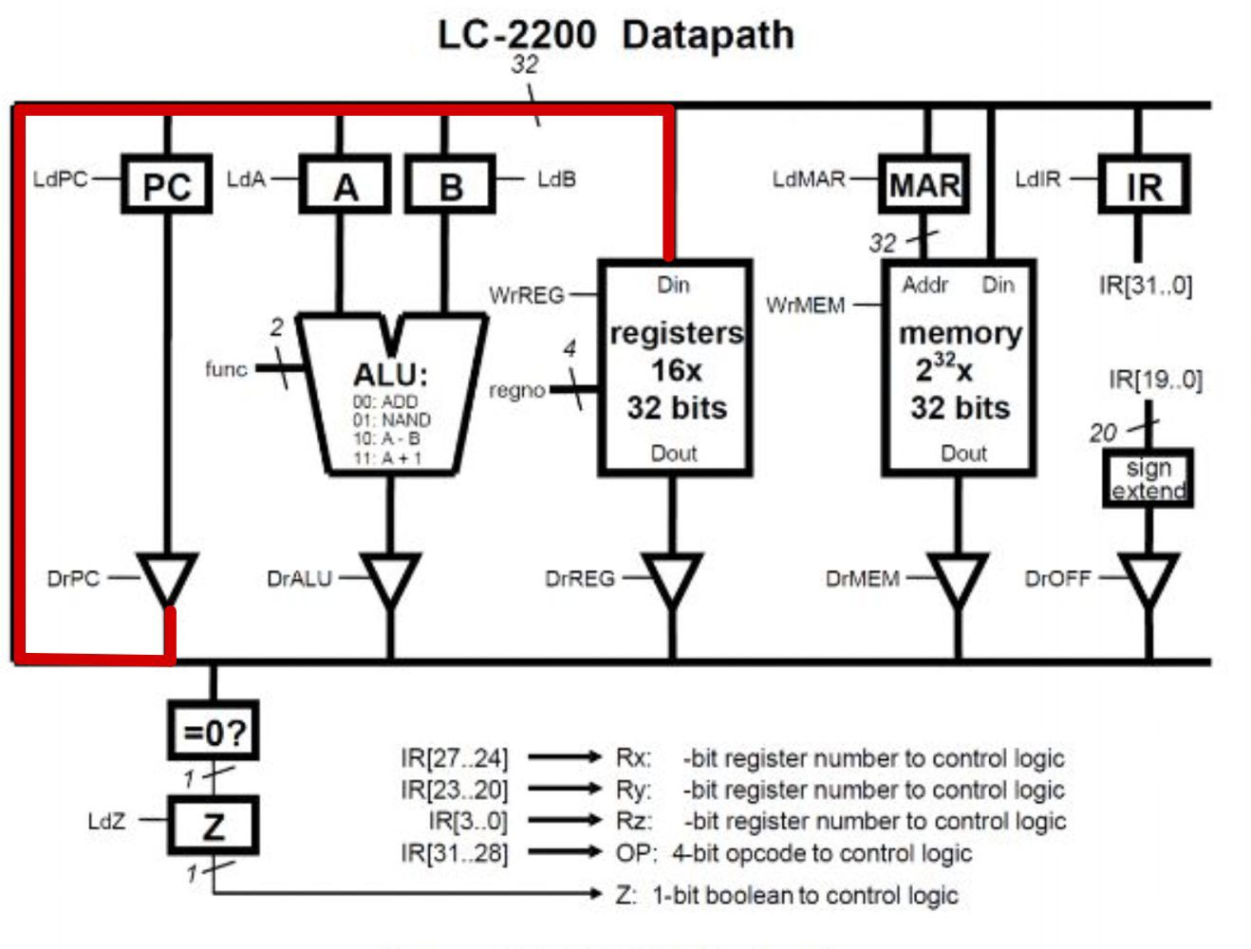
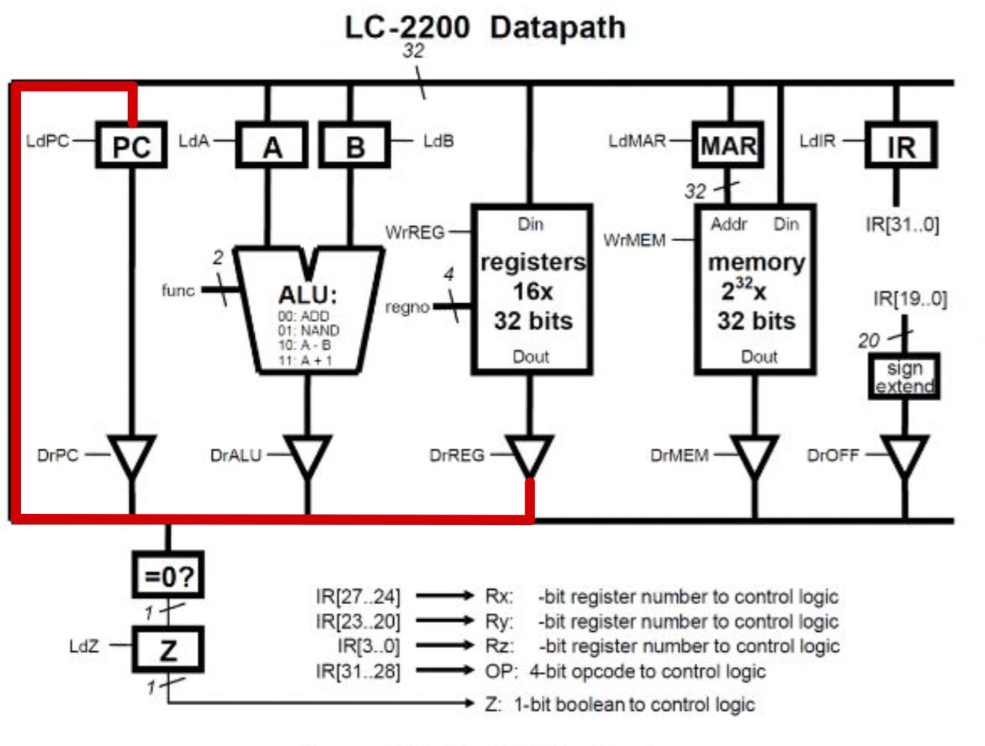
Implementing JALR
Ry ← PC + 1*
PC ← Rx
Cycle 1: DrPC, WrREG, regSel = 01
Cycle 2: DrREG, LdPC, regSel = 00
Note: By the time an instruction executes, the PC has already been incremented! We don’t have to do that again during the execution macrostate.

Slide 20
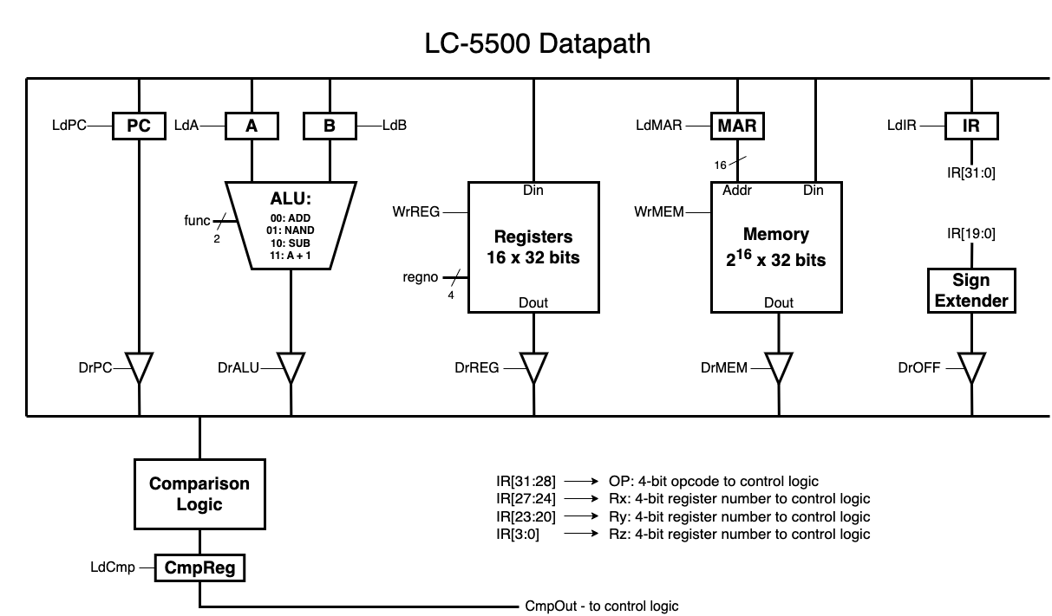
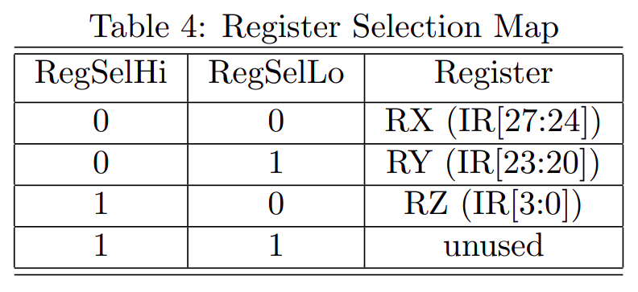
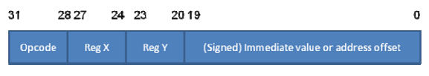
Exercise: Implement ADDI on LC-2200 datapath
How many cycles and what control signals are required to implement ADDI on the LC-2200 datapath? Spend 5 minutes tracing each cycle.
Anatomy of an I-type instruction.

Slide 21
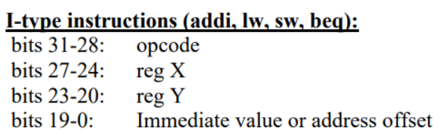
Implementing ADDI
Load Ry into A
Load sign extended offset into B
Add A and B and store in Rx

Slide 22
ADDI Cycle 1: Ry → A
What signals need to be asserted?

Slide 23
ADDI Cycle 1: Ry → A
DrREG, LdA, RegSel = 01

Slide 24
ADDI Cycle 2: OFF → B
What signals need to be asserted?

Slide 25
ADDI Cycle 2: OFF → B
DrOFF, LdB

Slide 26
ADDI Cycle 3: ALUout → Rx
What signals need to be asserted?

Slide 27
ADDI Cycle 3: ALUout → Rx
func = 00, DrALU, WrREG, RegSel = 00

Slide 28
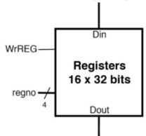
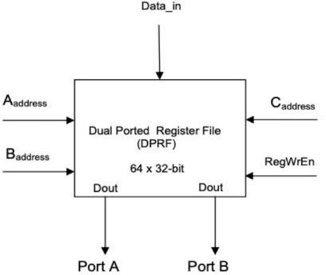
Single vs. Dual Ported Register File
Contains a collection of registers visible to the programmer:
Single Ported Register File
Allows for a single register read at a time
The LC-2200 register ﬁle is single-ported!
Dual Ported Register File
Allows for two register reads at a time
Requires additional address input
Can still only write to one register at a time

Slide 29
Exercise: What changes would we have to make to the datapath to support a DPRF?

Slide 30
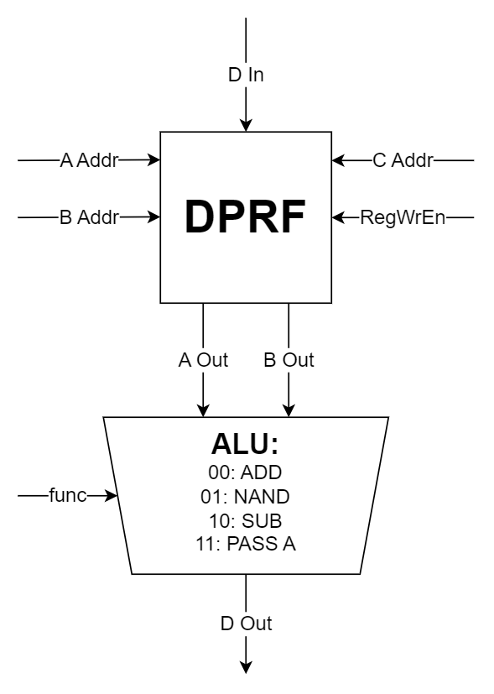
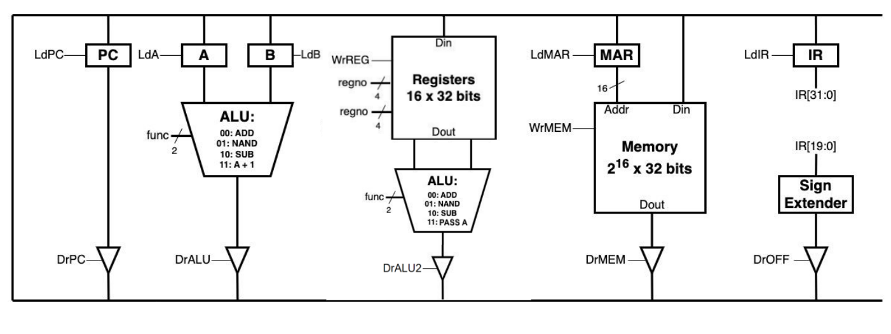
Solution: Adding a 2nd ALU makes things work out!

Slide 31
Microcontrollers

Slide 32

What does a Microcontroller Do?
The microcontroller (or control unit) is the “conductor” of the datapath
It controls all of the datapath’s components (Registers, ALU, memory) by periodically turning on their control signals (LdA, DrREG, func, WrMEM). This allows instructions to be executed!
Microcontroller
Microcontroller
LdA
LdB
Instruction passed in
func
Tristate
Buffers
DrALU
ALU
RAM
PC
regno
Registers
DrREG
WrREG

Slide 33
Finite State Machines
The microcontroller is essentially a massively complex finite state machine.
It outputs the control signals associated with 1 microstate
Then it moves onto the next microstate, turning on different control signals
But how do we do know which state comes next?
Microcontroller
(FSM)
LdA
LdB
Instruction passed in
func
DrALU
regno
DrREG
WrREG

Slide 34
A Very Simple ROM (Read Only Memory) Design
To keep track of which state comes next, we can use a ROM
The state the datapath is currently executing = a memory address in the ROM. We use a state register to keep track of this.
The contents of the ROM at that address is all of the signals that need to be turned on, plus the address of the entry of the state that comes next.
Current State goes in (Address in ROM)
Control Signals & Next State go out (aka ROM[Current State])
ROM
LdA
LdB
func
DrALU
regno
DrREG
WrREG
Next State
State Register temporarily holds the next state, which then becomes the current state on the next clock cycle
State Register

Slide 35
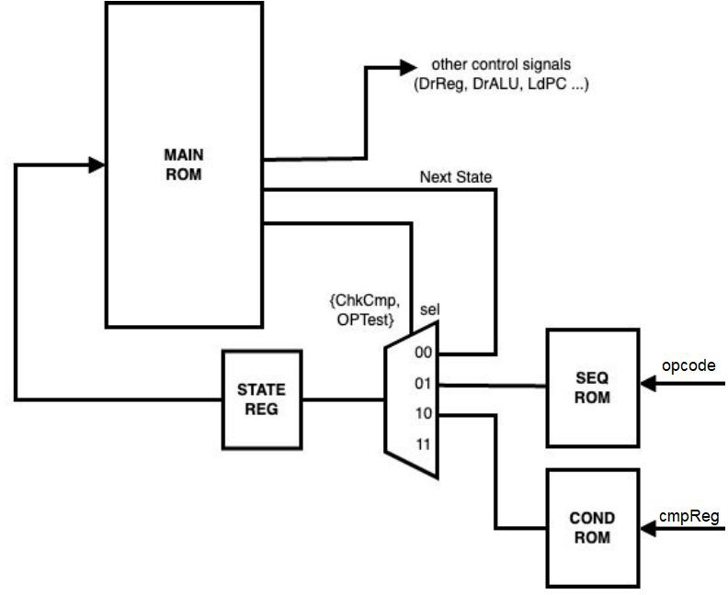
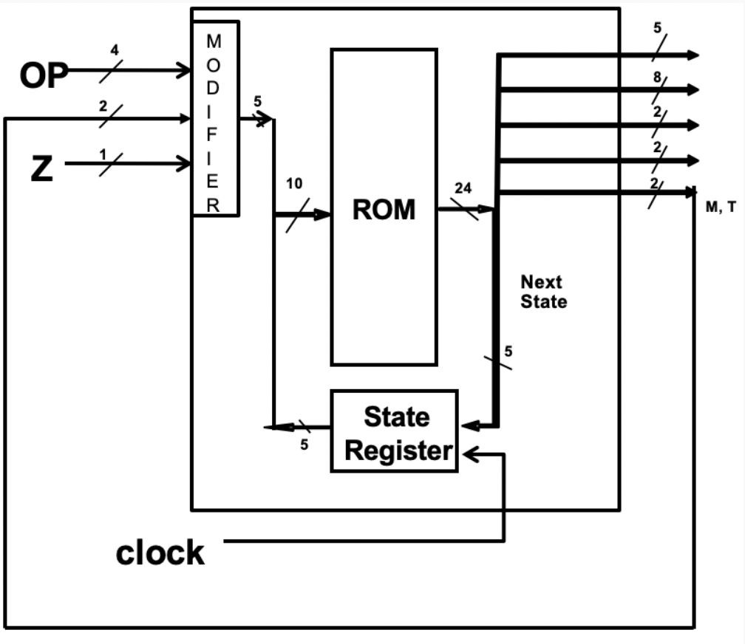
Detailed ROM Designs for Microcontrollers
Flat ROM vs 3-ROM

Slide 36
Flat ROM Details

Slide 37
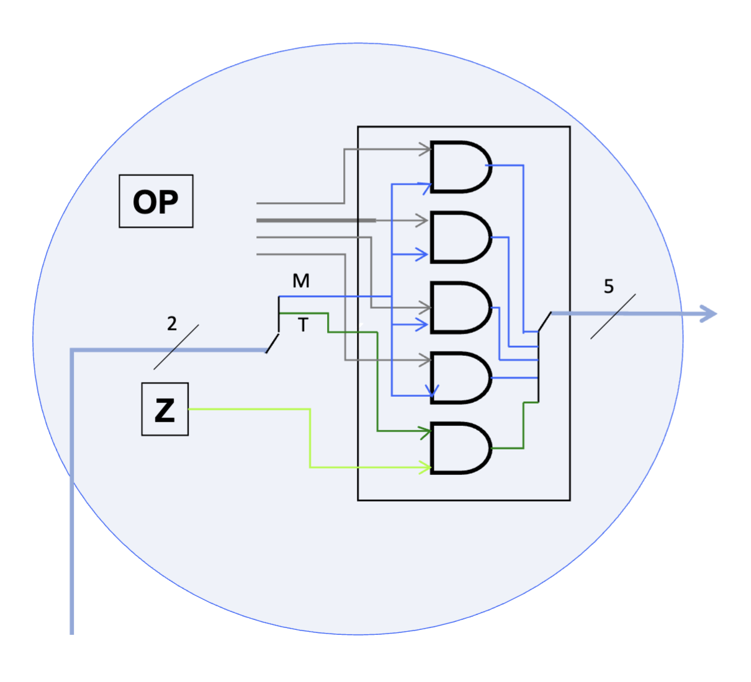
Modifier Subcircuit

Slide 38
M Bit
The M bit is on when we want to read the OP code from the IR to modify the NextState address.
The M bit is on in fetch3 and throughout the execute macrostate.
So for an add instruction, the M bit would be on for each of it’s microstates (add1, add2, add3).

Slide 39
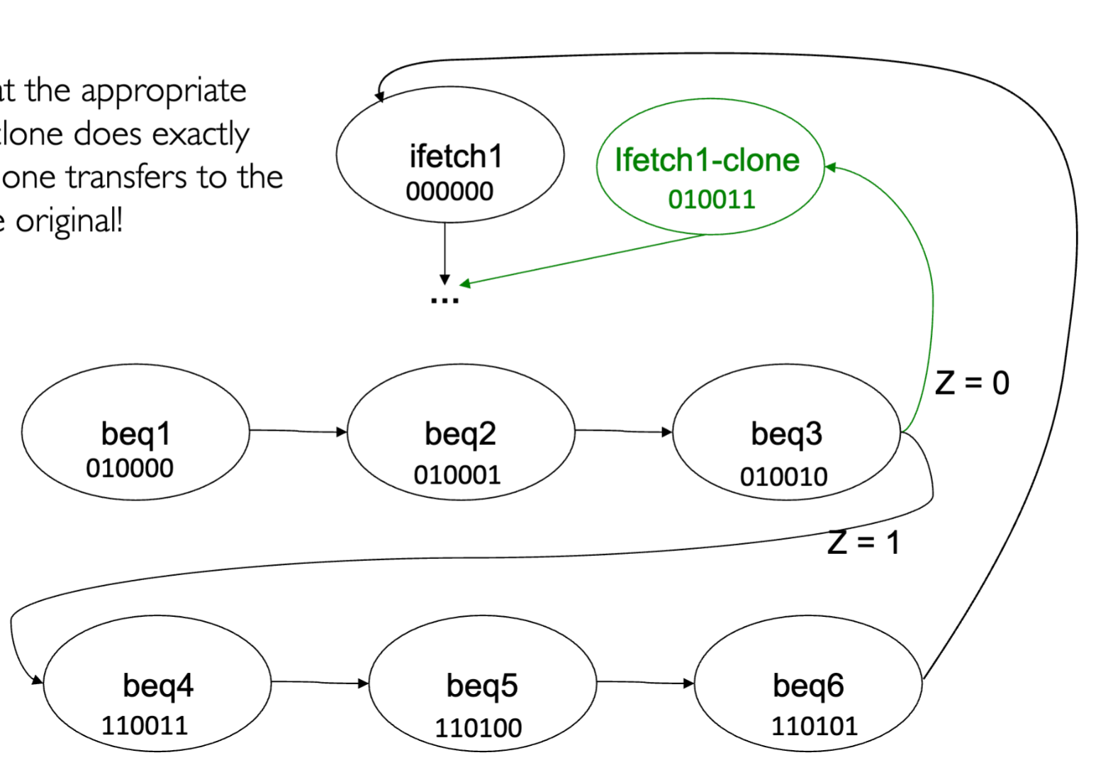
T & Z Bits
The Z bit indicates the value of the Z Register. The Z register captures whether 2 registers are equal to each other.
Think of the Z bit like the CmpOut signal in the LC-5500
The T bit indicates when to use the Z bit to modify the NextState address. The T bit is on in beq3.
Note that ifetch1-clone’s next state is ifetch2

Slide 40
Discontinuities:
Interrupts, Exceptions, Traps

Slide 41
Comparison
 | Interrupts | Traps | Exceptions
Occurrence | Usually due to I/O devices | Allows user to access protected OS resources | Illegal/exceptional behavior in program
Async/Sync | Asynchronous | Synchronous | Synchronous
Intentional? | Yes | Yes and No | Yes and No
Source | External | Internal | Internal
Synchronous - Occurs at well-deﬁned points in time and in sync with CPU
Asynchronous - Occurs at random time intervals based on user/device inputs, out-of-sync with CPU

Slide 42

Program Discontinuities
Sometimes we must temporarily halt execution to perform some necessary user task. eg: keyboard input
Analogy: Teacher stopping lecture to answer a student’s question.
Need to be able to seamlessly exit and re-enter a program without affecting its ﬂow.
Analogy: Teacher resumes lecture after answering the question.

Slide 43



Exercise: Which is which?
Identify the following as interrupts, traps, or exceptions
int x = 10/0;
(stack overflow error)
memory allocation
Segfault
Force quit program
System call

Slide 44
Solution: Which is which?
Identify the following as interrupts, traps, or exceptions
int x = 10/0;
<exception>
<interrupt>
(stack overflow error)
<exception>
memory allocation
<trap>
Segfault
<exception>
Force quit program
<interrupt>
System call
<trap>
<interrupt>

Slide 45
Thanks for Attending :)

Slide 46
Handling Interrupts

Slide 47
Dealing with Discontinuities
We’ve defined what our possible discontinuities are (interrupts, traps, exceptions)
But how are we going to deal with them?
We need a procedure that tells the processor to stop whatever it’s currently doing, deal with the interrupt, then resume its normal thing.
Program normally executing
Discontinuity Detected
Handle the Interrupt

Slide 48
Handlers
Handlers are simply just code/programs for dealing with an interrupt
When an interrupt/discontinuity is detected, the processor will pause it’s execution of the normal program and run the handler.
{code here for
dealing with the
Interrupt}
PC = value in $k0
// Resumes our original
// program
$k0 is simply a reserved register for saving the current PC before going to handle the interrupt.
Before a handler is executed, the original PC value is saved in $k0

Slide 49

Handlers
Handlers require that we save the state of the processor (mainly its registers) so that when we’re done handling the interrupt, we can resume our original program.
This can be incredibly tricky, as if an interrupt occurs while we’re trying to save the state of processor, we need to make sure it doesn’t overwrite or lose that original state!
If the original state is lost, it may be impossible to return to our original program!
POV: $k0’s OG value gets permanently lost

Slide 50
Handlers
Example: a faulty handler procedure
Save $k0 to System Stack
Save ALL registers onto System Stack
{code here for
dealing with the
Interrupt}
Restore ALL registers from System Stack
Restore $k0 from System Stack
PC = value in $k0
To save the state of the processor, we can store them on the System Stack!
The System Stack works similar to our standard Stack (aka the User Stack), but it’s kept separate.

Slide 51
Handlers
Example: a faulty handler procedure
We save $k0 to the system stack so that if an interrupt occurs while the middle Interrupt-handling code is executing, we can simply restore it by popping it off the stack
But what if an interrupt occurs while we are saving or restoring $k0? Or if we are restoring the PC?
Save $k0 to System Stack
Save ALL registers onto System Stack
{code here for
dealing with the
Interrupt}
Restore ALL registers from System Stack
Restore $k0 from System Stack
PC = value in $k0

Slide 52
Handlers
Example: a faulty handler procedure
We save $k0 to the system stack so that if an interrupt occurs while the middle Interrupt-handling code is executing, we can simply restore it by popping it off the stack
But what if an interrupt occurs while we are saving or restoring $k0? Or if we are restoring the PC?
WE LOSE $k0’s original value!
Save $k0 to System Stack
Save ALL registers onto System Stack
{code here for
dealing with the
Interrupt}
Restore ALL registers from System Stack
Restore $k0 from System Stack
PC = value in $k0

Slide 53
Exercise: Protecting $k0
What are some ways to prevent $k0 from being overwritten by an interrupt?

Slide 54
Solution: Protecting $k0
What are some ways to prevent $k0 from being overwritten by an interrupt?
→ Solution 1: Disabling/Enabling Interrupts
→ Solution 2: Atomic Instructions
Both prevent a discontinuity from interfering with important procedures (mainly saving/restoring the PC and $k0).

Slide 55
Handlers
Example: A better handler procedure
Save $k0 to System Stack
Enable Interrupts
Save ALL registers onto System Stack
{code here for
dealing with the
Interrupt}
Restore ALL registers from System Stack
Disable Interrupts
RETI ($k0->PC, Restore mode from the system stack, and enables interrupts atomically)
Interrupts are disabled before executing the handler.
We purposely enable/disable interrupts to allow us to safely save $k0 on the stack.
We create an atomic RETI instruction to atomically save $k0 and enable interrupts, allowing safe restoration.

Slide 56
Exercise: Handling Discontinuity
The OS should be able to handle any discontinuity Where does the responsibility fall?
Microarchitecture
ISA

Slide 57
Solution: Handling Discontinuity
The OS should be able to handle any discontinuity Where does the responsibility fall?
Microarchitecture
ISA
Detecting discontinuities
Jumping to event handling subroutine
Executing subroutine
Return back to original program

Slide 58
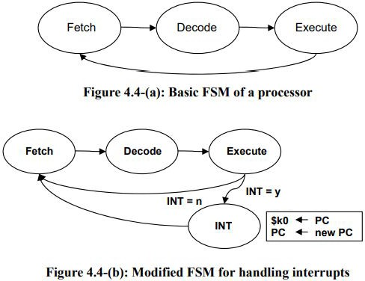
How to INT
When and how do we check if an interrupt has occurred?
After each execute macrostate, we check for pending interrupts
Interrupt (INT macrostate):
disable interrupts
save the PC to $k0
save the current mode onto the stack
load a new PC value to jump to the interrupt handling code
continue to fetch state
No Interrupt:
continue to fetch state
Notes:
Note: When it’s actually implemented in real life, we check for interrupts in ifetch1 instead of at the end of every execute state because it saves a clock cycle for each execute <- the alternative (how the LC2200 implements it) is checking for every instruction (instead of going back to fetch, check interrupt, and that microcode will then go back to fetch IF there is no interrupt)

Slide 59
IVT
handler code for divide by 0
IVT
How do we find the handler program?
0
…
…
…
…
Handler for divide by 0
handler code for page faults
exceptions
…
Each interrupt has a unique number called a vector
The Interrupt Vector Table (IVT) uses the unique number to map it to the associated handler code
Handler for page faults
handler code for system call
traps
Handler for system call
…
Handler for keyboard
handler code for keyboard
IVT is a ﬁxed-size table of handler addresses
Usually starts at the bottom (0x0) in memory
n-1
interrupts
Handler for mouse
handler code for mouse

Slide 60

ETR
When a processor detects a discontinuity/interrupt, it will place that interrupt’s vector into a small register, called the Exception/Trap Register (ETR)
From here, the processor can simply grab the vector from the ETR and pass it off to the IVT

Slide 61
Summary: The IVT and ETR
Discontinuity Detected
!
Vector value of the interrupt placed in the ETR
Vector value used to look up address of the handler in the IVT
Processor saves PC to $k0, prepares for handler, then jumps to handler.
handler starts executing
✔
x0107
x0105
x9018
PC = x7621
x0106
x7231
x0107
x7621
x0108
x8390
x0109
x7775
x010A
x9873

Slide 62
Finalized INT + Interrupt Handler Steps
INT macrostate:
Save the PC to $k0
Load a new PC value to jump to the interrupt handling code
Save the mode onto the system stack
Switch the mode to kernel if not already in kernel mode
Disable interrupts (DI)
RETI:
Load PC from $k0
Restore mode from the system stack
Enable interrupts (EI)

